Slide 1
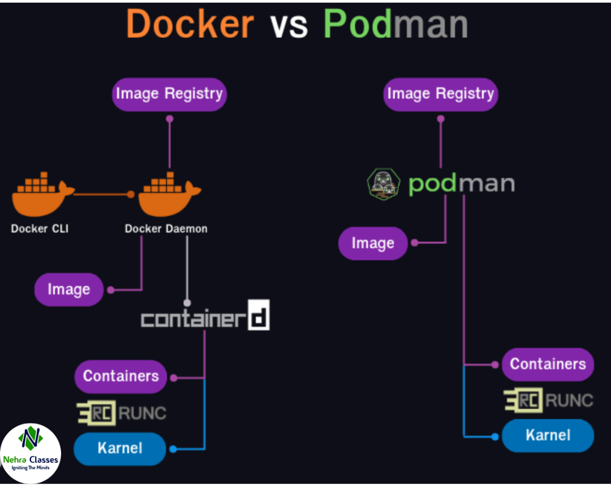
Docker Vs Podman
Docker Vs Podman:
Podman and Docker are both containerization tools, but they have some key differences that make each suitable for different scenarios.
Architecture:
Docker: Has a client-server architecture. The Docker daemon manages images, containers, networks and storage, while the Docker CLI interacts with the daemon.
Podman: Does not rely on a daemon. Instead, it’s daemonless, which allows it to run as a non-root user without any long-running background services.

Slide 2
Docker Vs Podman
Docker Vs Podman:
Mode of Operation:
In container environments, rootless and rootful modes refer to the permissions with which containers are executed and managed, impacting security, usability and compatibility.
Rootful Mode:
In rootful mode, containers are executed with root (administrator) privileges. This means the container process has unrestricted access to the host’s resources, including the filesystem, network, and hardware, which can introduce security risks if not carefully managed.
Benefits:
Full Control: Direct access to all host resources, making it ideal for complex setups needing advanced configurations.
Compatibility: Supports more applications and tools that may require root permissions.

Slide 3
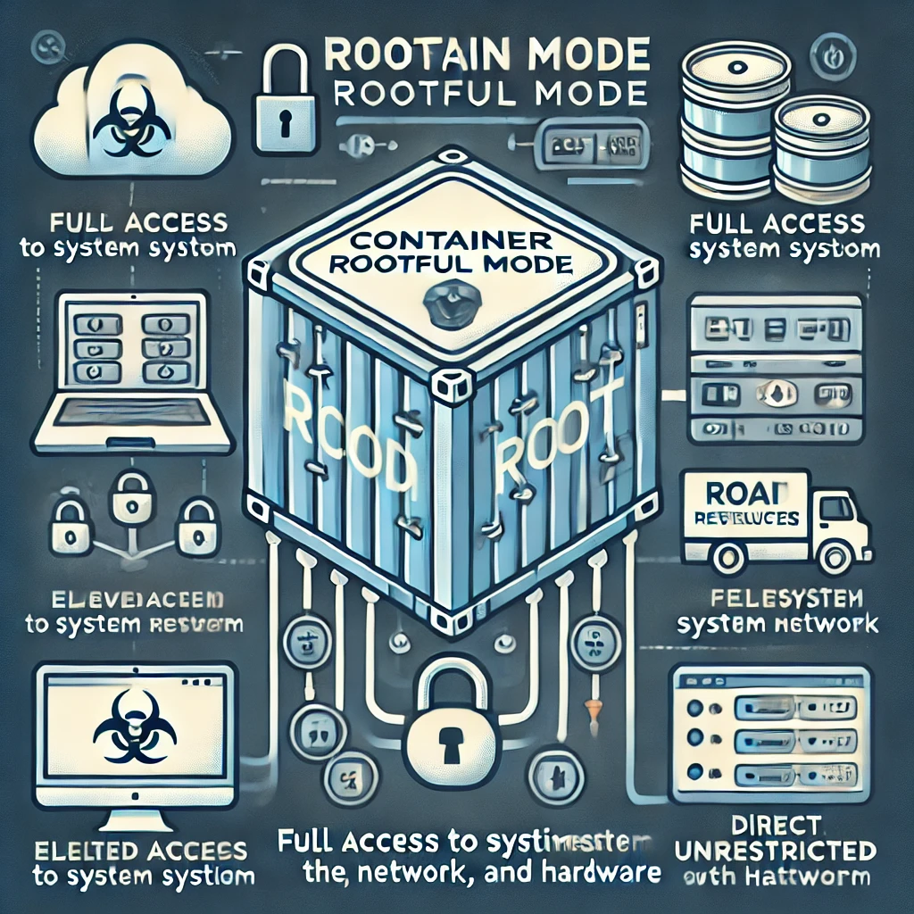
Docker Vs Podman
Docker Vs Podman:
Risks:
Security: Containers with root privileges could access sensitive host resources if compromised.
Isolation: Rootful containers can potentially affect host integrity if vulnerabilities exist within the container or its dependencies.

Slide 4
Docker Vs Podman
Docker Vs Podman:
Rootless Mode:
In rootless mode, containers are executed without root privileges, meaning they run as a regular user with limited access to the host system. Rootless mode is supported by tools like Podman and recent versions of Docker, and it focuses on enhanced security by isolating the container more strictly from the host.
Benefits:
Enhanced Security: Containers don’t have root access to the host, reducing risks of host compromise.
User Flexibility: Allows non-admin users to run containers, useful in multi-user systems where root access is limited or restricted.

Slide 5
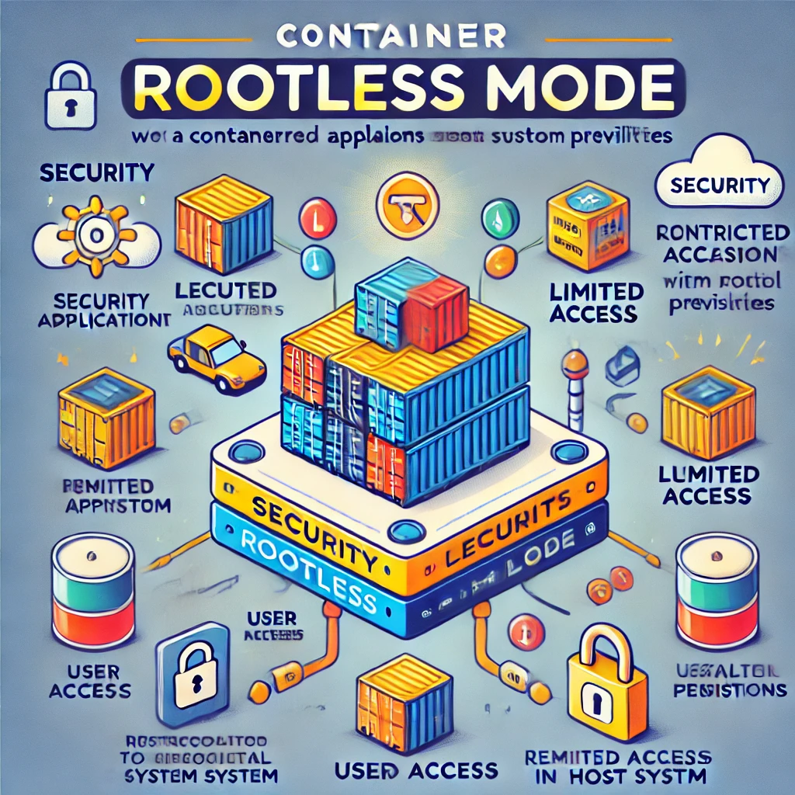
Docker Vs Podman
Docker Vs Podman:
Limitations:
Reduced Access to System Resources: Some configurations and applications may not run if they require root access.
Compatibility Challenges: Not all container-based applications support rootless mode, especially older or highly privileged ones.

Slide 6
Docker Vs Podman
Docker Vs Podman:
Compatibility:
Docker: Widely used with a mature ecosystem. Compatible with most container tools and platforms.
Podman: Has Docker-compatible CLI options, so commands for Docker can usually work for Podman. It can serve as a direct replacement in many use cases.
Networking:
Docker: Has a default network with built-in isolation but requires docker network commands for customization.
Podman: Uses CNI (Container Network Interface) plugins for networking, which provide modular networking capabilities and can integrate into more complex network configurations.

Slide 7
Docker Vs Podman
Docker Vs Podman:
Volume Management:
Docker: Docker volumes require explicit management; Docker handles volume mounting and storage.
Podman: Similar volume management to Docker, but Podman volumes are linked to user permissions, especially in rootless mode.
Orchestration:
Docker: Has built-in support for Docker Swarm, which can orchestrate services at a smaller scale.
Podman: Lacks native orchestration but works with Kubernetes YAML, allowing easy deployment to Kubernetes clusters or usage with tools like Kube.

Slide 8
Docker Vs Podman
Docker Vs Podman:
Image Management:
Docker: Uses Docker Hub as its primary registry, though it supports other registries as well.
Podman: Supports multiple container registries out-of-the-box, including Docker Hub, Red Hat Quay and many more.
Performance and Resource Usage:
Docker: The Docker daemon can consume significant memory and CPU, especially in large deployments.
Podman: The absence of a daemon can reduce overall resource usage, especially for small workloads or isolated development environments.

Slide 9
Docker Vs Podman
Docker Vs Podman:
Security:
Docker: Requires careful management of daemon permissions; however, Docker is more widely audited and thus has a stable security profile.
Podman: By design, Podman’s daemonless, rootless operation adds a security layer by limiting the need for elevated permissions.

Slide 10
Docker Vs Podman
Docker Vs Podman:
Feature | Podman | Docker
Architecture | Daemonless (no central daemon) | Daemon-based architecture
Rootless Mode | Yes, designed to work rootless by default | Supports rootless, but daemon runs as root by default
Compatibility with Docker CLI | Supports Docker CLI with alias docker=podman | Native Docker CLI
Container Lifecycle | Separate processes for each container | Containers managed by the Docker daemon
Container Management | Allows management of individual containers directly | Docker daemon manages all containers together

Slide 11
Docker Vs Podman
Docker Vs Podman:
Feature | Podman | Docker
Kubernetes Compatibility | Supports podman generate kube to export Kubernetes YAML | Supports Kubernetes but with additional tools (like kompose)
Systemd Integration | Easily integrates with systemd for container services | Limited integration, but possible with custom configuration
Networking | Uses CNI (Container Network Interface) plugins for networking | Uses built-in Docker networking (bridge, overlay)
Swarm Support | No, only Kubernetes-focused | Yes, supports Docker Swarm for orchestration
Installation Size | Lighter and has fewer dependencies | Generally heavier due to daemon overhead

Slide 12
Docker Vs Podman
Docker Vs Podman:
Feature | Podman | Docker
Volume Management | Compatible with Docker volumes, supports named volumes | Standard Docker volumes
Image Management | Uses OCI-compatible images and Docker Hub | Docker Hub is default, uses OCI-compatible images
Security | No daemon running as root, each container process can have its own user | Docker daemon often runs as root, adding potential security risks
Integration with CRI-O | Yes, Podman can work with CRI-O, making it Kubernetes-friendly | No native support for CRI-O, primarily Docker runtime
Docker Compose Support | Not directly supported (Podman Compose is an alternative) | Fully supports Docker Compose

Slide 13
Docker Vs Podman
Docker Vs Podman:
Feature | Podman | Docker
Resource Management | Each container process is isolated and managed independently | Resource constraints applied through the daemon
Image Build | buildah tool used for building images | Native docker build command
Performance | Generally better with fewer resources needed due to lack of daemon | Good performance but with higher memory usage due to daemon
Ease of Use for Beginners | Some learning curve if used to Docker's daemon-based model | Easier for beginners due to widespread documentation and usage
License | Apache 2.0 | Docker Community Edition: Open Source; Docker Enterprise Edition: Commercial

